Slide 1
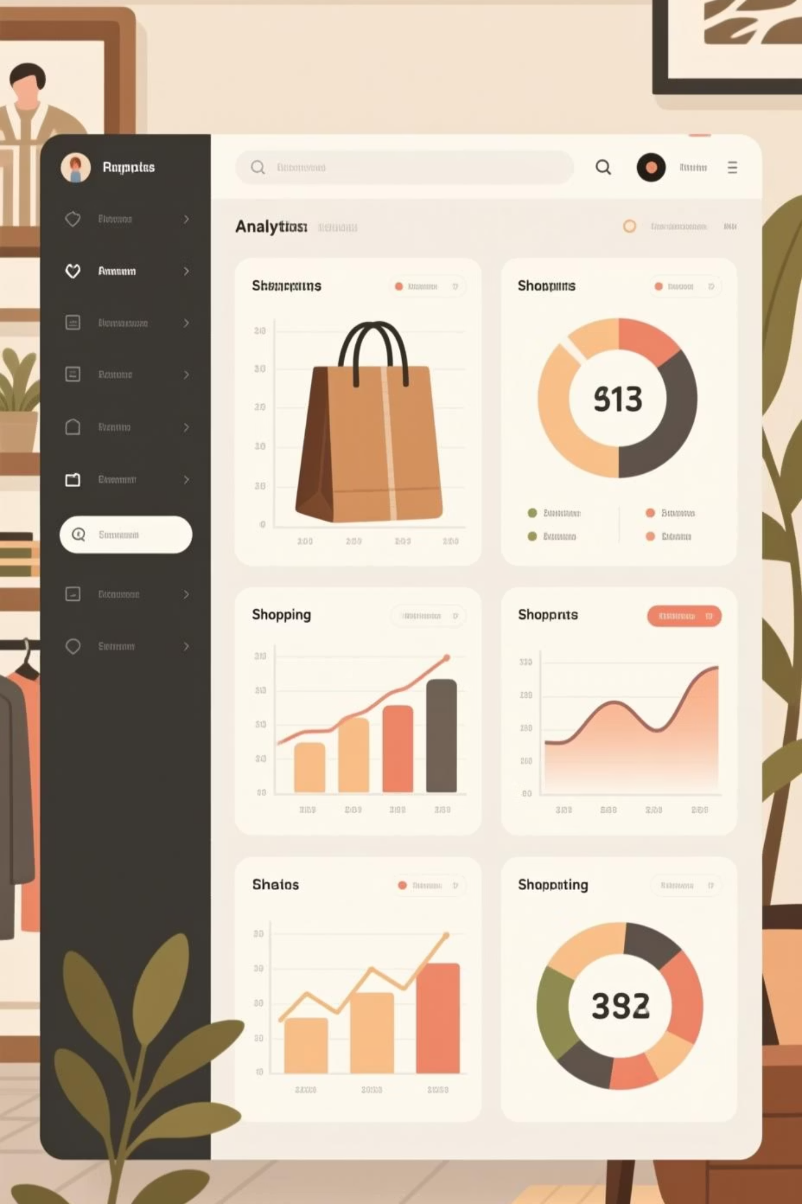
Customer Shopping Behavior Analysis
Uncovering insights from 3,900 purchases to guide strategic business decisions

Slide 2
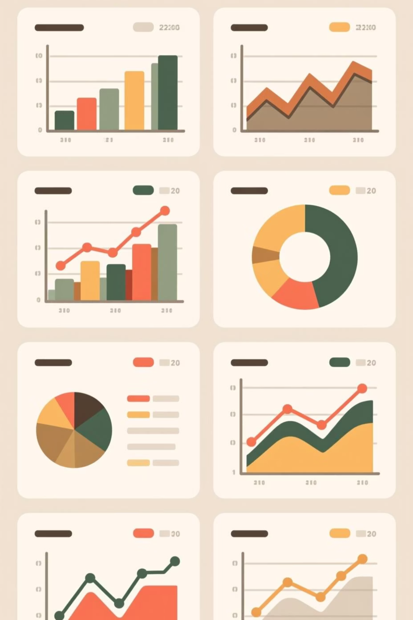
Dataset Overview
3,900
18
$59.76
Total Purchases
Data Points
Average Purchase
Transactions analyzed
Features per customer
Per transaction
3.75
Review Rating
Average customer satisfaction
Comprehensive dataset covering demographics, purchase details, and shopping behavior across multiple categories

Slide 3

Data Preparation Process
01
02
Data Loading & Exploration
Missing Data Handling
Imported dataset, checked structure and summary statistics
Imputed 37 missing review ratings using category medians
03
04
Feature Engineering
Database Integration
Created age groups and purchase frequency metrics
Connected to PostgreSQL for advanced SQL analysis

Slide 4
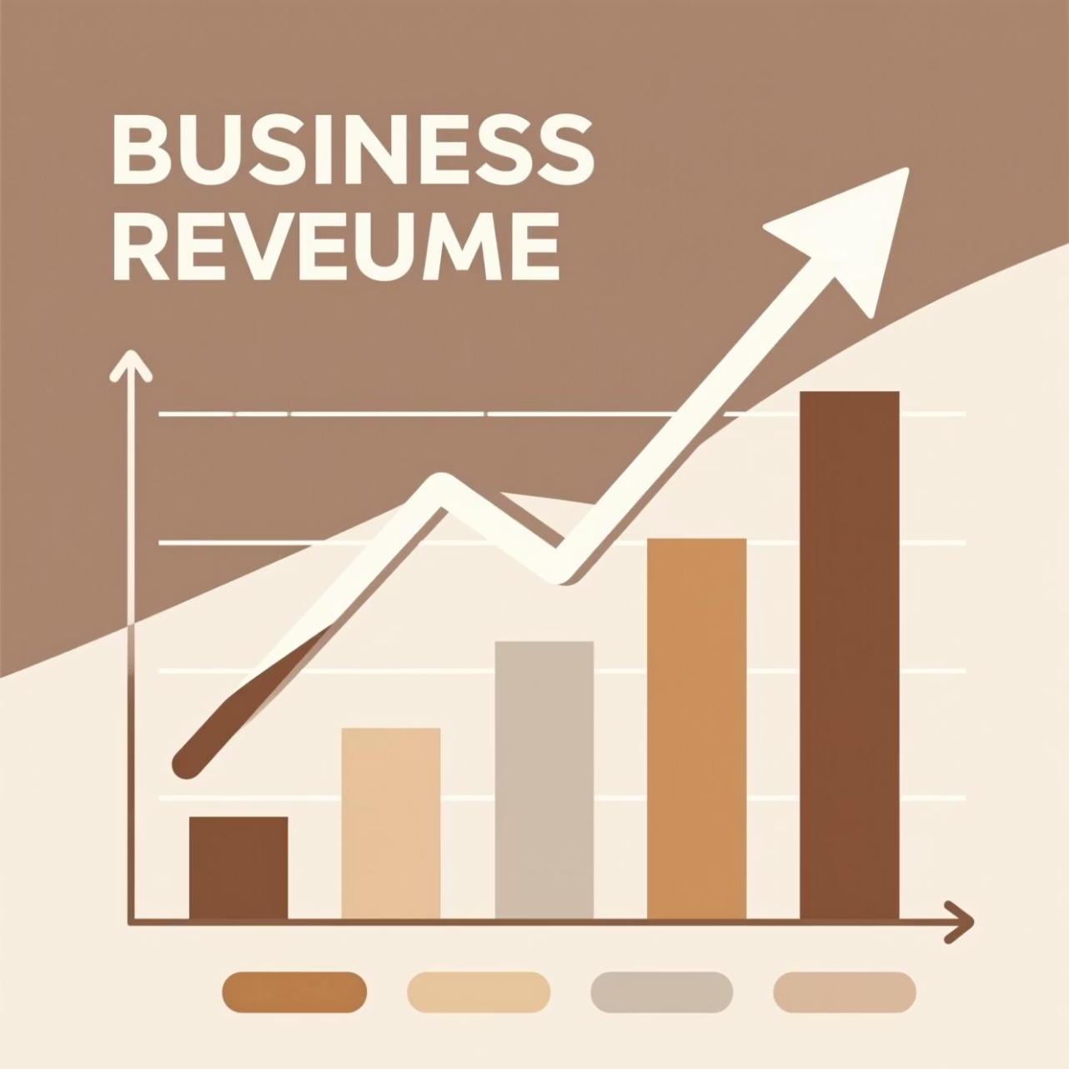
Revenue Insights
Gender Revenue Comparison
Male customers: $157,890
Female customers: $75,191
Male customers generate 2.1x more revenue
Shipping Type Analysis
Express: $60.48 average
Standard: $58.46 average
Express shipping users spend slightly more per order

Slide 5
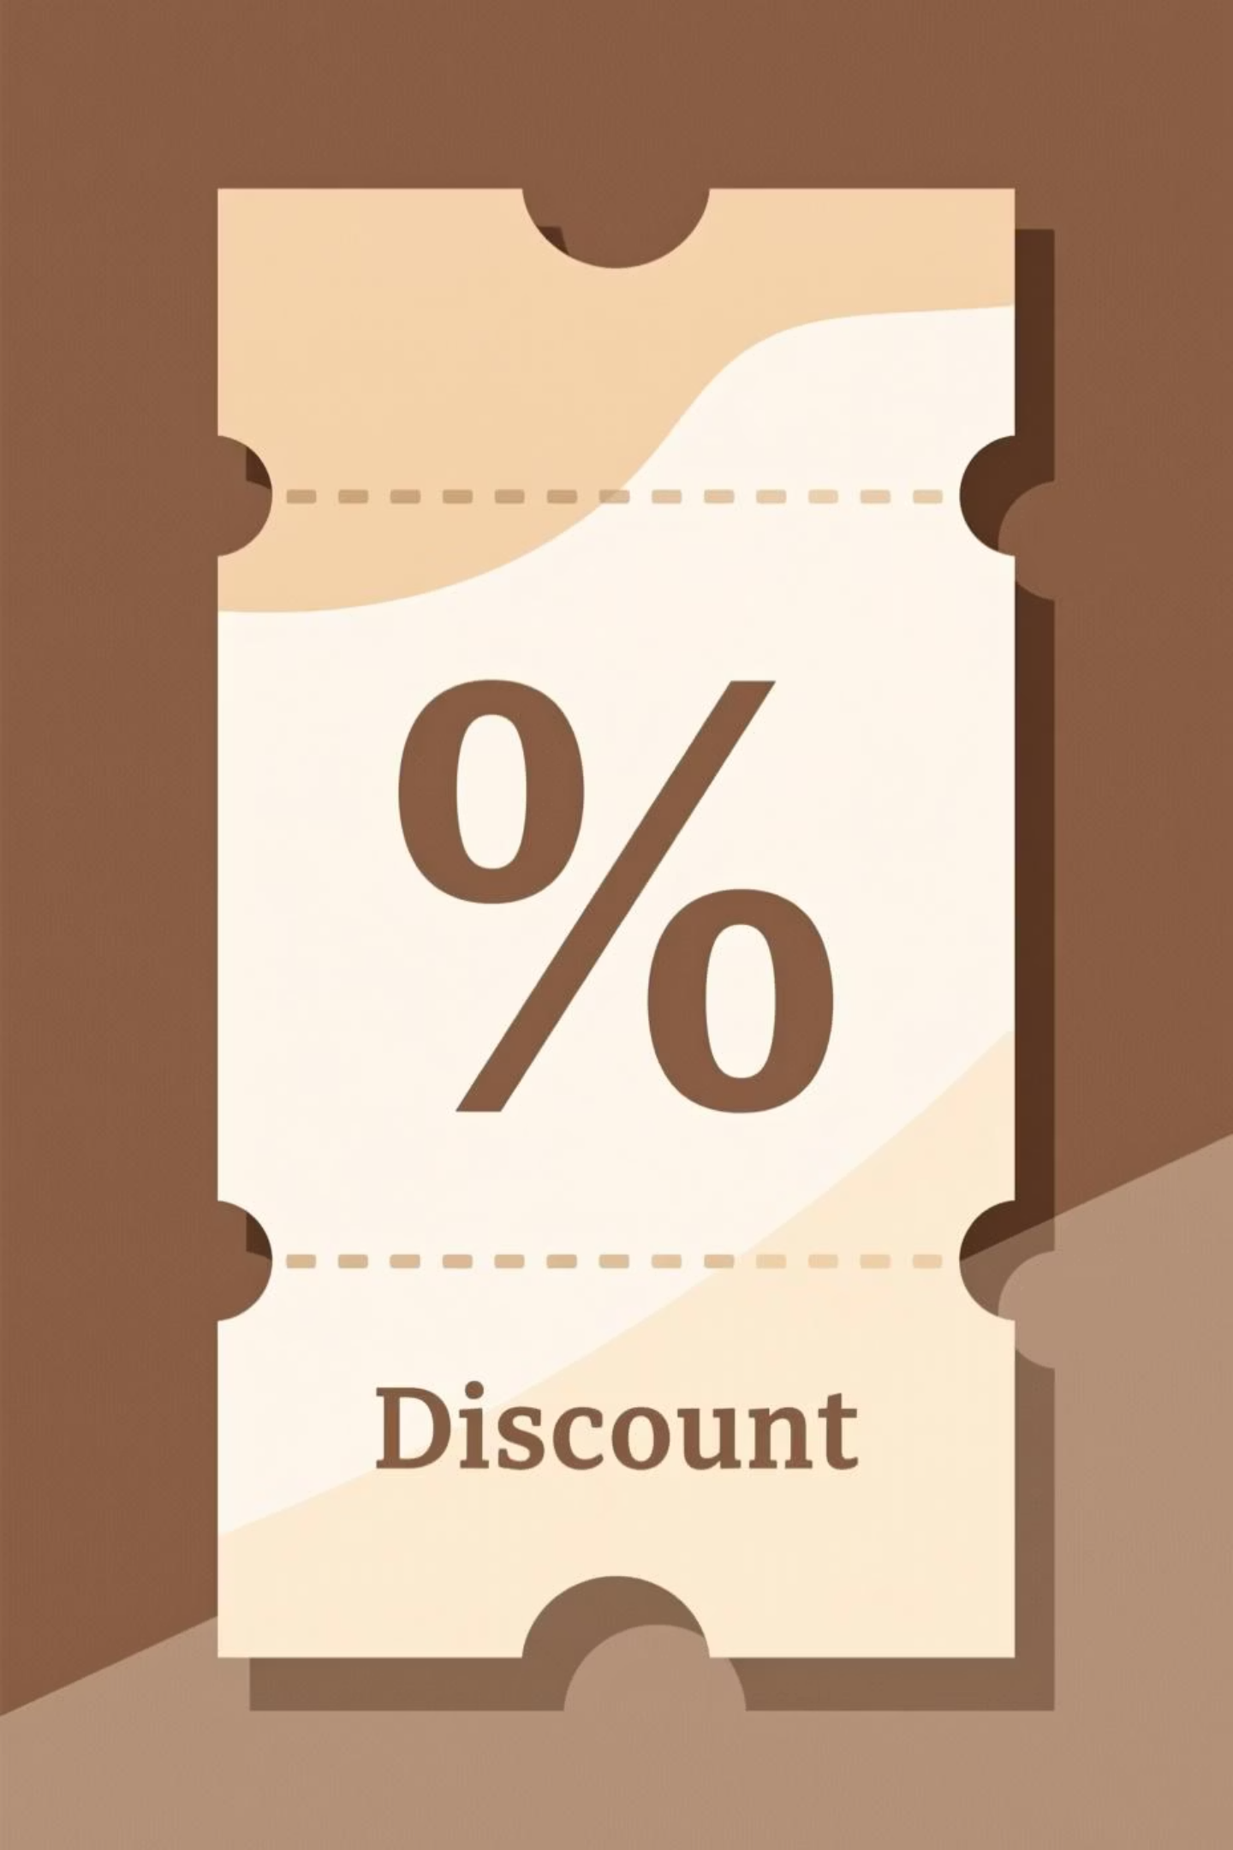
High-Value Discount Users
Strategic Finding
Customers using discounts still paid above average purchase amount
Business Implication
Discounts drive volume without sacrificing transaction value
Balance promotional strategy to maximize both sales and margins

Slide 6

Top Performing Products
Gloves
Sandals
Boots
3.86 rating
3.84 rating
3.82 rating
Hat
Handbag
3.80 rating
3.78 rating
Highest-rated products show consistent customer satisfaction

Slide 7



Customer Segmentation
Returning
701 customers
2-10 purchases
Loyal
3,116 customers
10+ purchases
New
83 customers
1 purchase

Slide 8


Subscription Analysis
Repeat Buyers (5+ purchases)
Subscribers: 958
Non-subscribers: 2,518
27%
Significant opportunity to convert loyal customers into subscribers
Subscribers
1,053 customers
73%
Non-Subscribers
2,847 customers

Slide 9
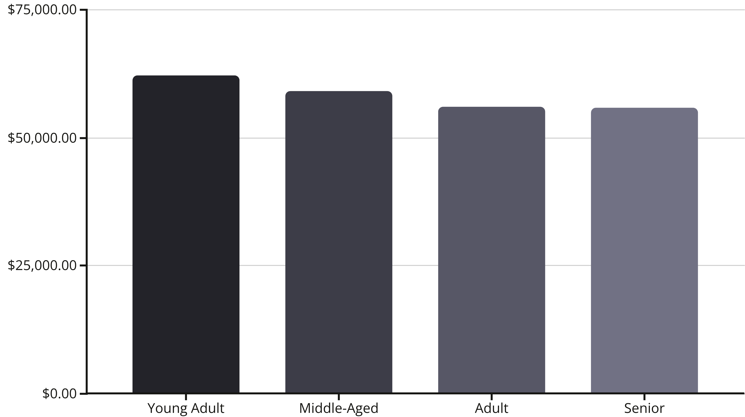
Revenue by Age & Category
Clothing
Accessories
$104K revenue | 1.7K sales
$74K revenue | 1.2K sales
Footwear
Outerwear
$36K revenue | 0.6K sales
$19K revenue | 0.3K sales

Slide 10





Strategic Recommendations
Boost Subscriptions
Promote exclusive benefits to convert loyal customers
Loyalty Programs
Reward repeat buyers to increase retention
Optimize Discounts
Balance promotional sales with margin control
Targeted Marketing
Focus on high-revenue segments and top products

